Slide 1

Exploratory Data Analysis
Descriptive Statistics & Outliers
DATA ANALYTICS

Slide 2
Table of Contents
Part I: Introduction and Univariate Analysis
What’s EDA
Key Concepts
Data types
EDA Framework
Univariate Analysis techniques
(in another deck)
Part II: Bivariate Analysis and Outliers
Bivariate Analysis techniques
Atypical values (Outliers)

Slide 3
What’s EDA (Exploratory Data Analysis)

Slide 4

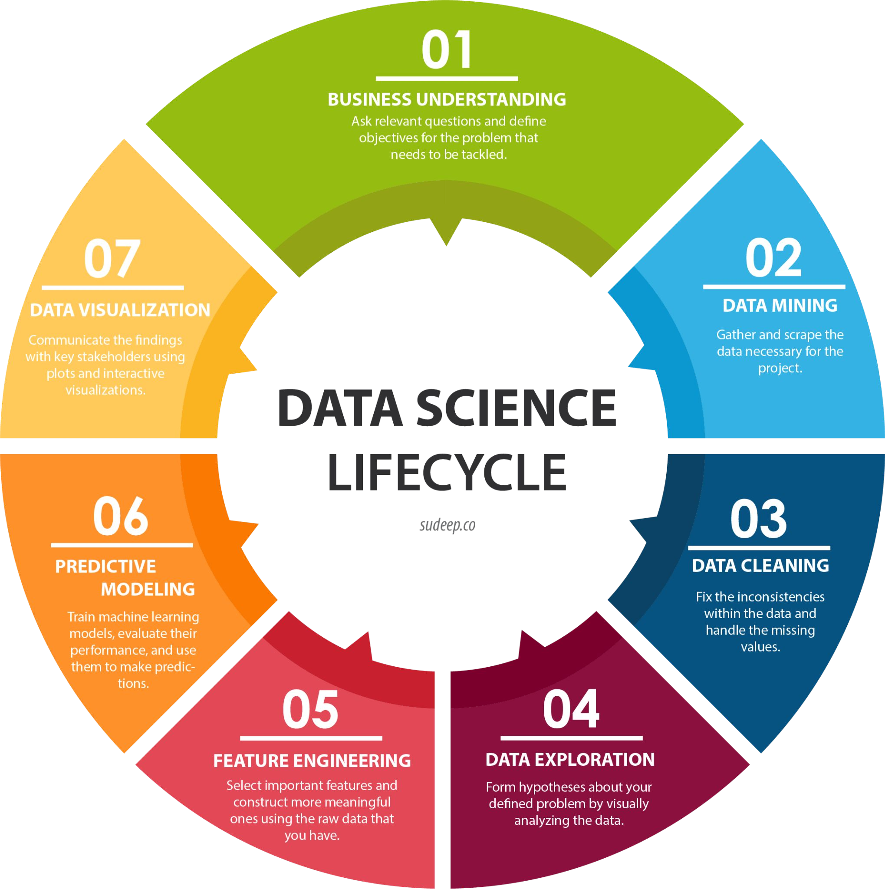
Lifecycle

Slide 5
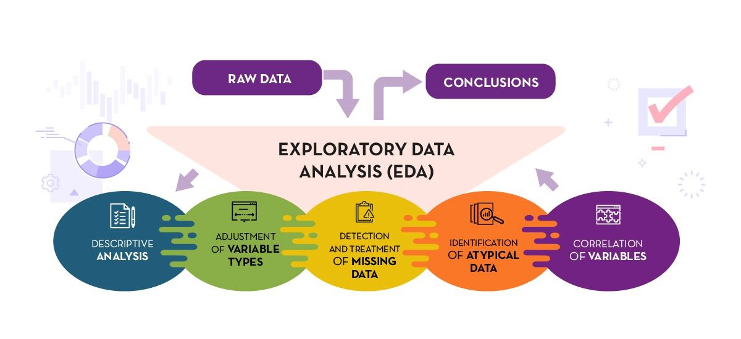
What is EDA?
EDA is an iterative process that requires a combination of domain knowledge, intuition, and technical skills. The objective is to explore, summarize, and understand the underlying patterns, relationships, anomalies, and structures in data to inform further analysis and hypothesis formulation.

Slide 6
What is EDA?
EDA comprehends:
Descriptive Statistics: numerical and visual techniques that describe data
Multivariate Analysis: techniques such as PCA
Pattern and Anomaly Detection: this includes spotting outliers or unusual clusters.
Data Cleaning: understanding missing data, possible errors, or inconsistencies in the dataset. EDA often leads to data cleaning and preprocessing steps.
Assumption Checking: checks assumptions related to subsequent statistical tests or modeling. For instance, checking for normality or homoscedasticity.
Complex Data Types Exploration: such as Time Series Analysis or Spatial Data Analysis.
Interactive Data Exploration

Slide 7
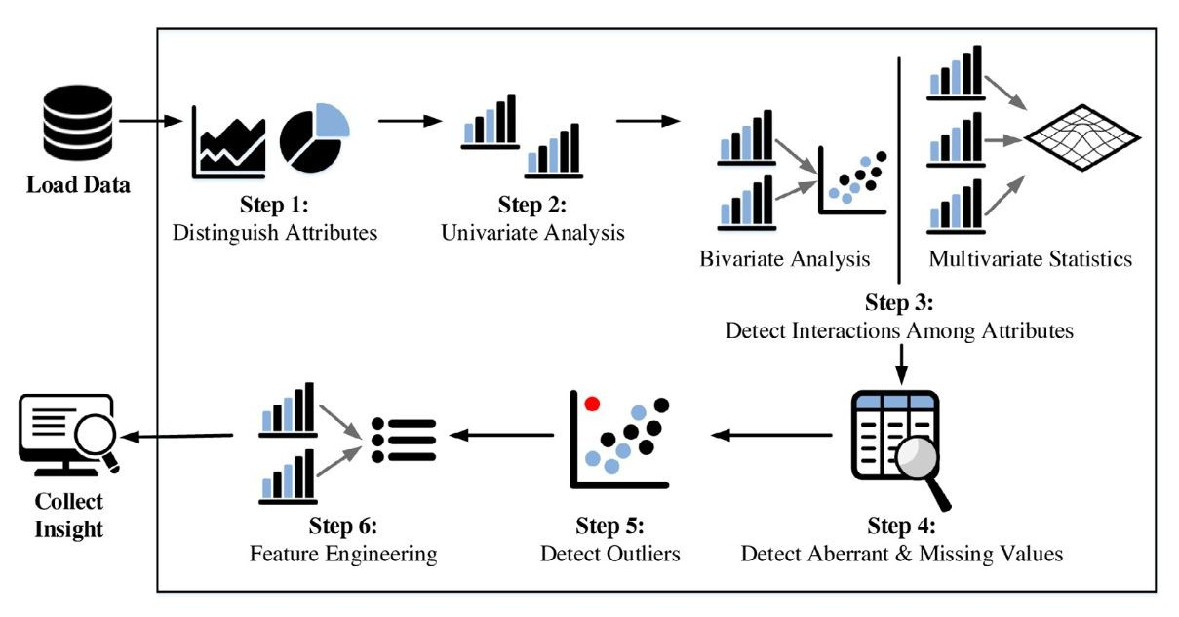
What is EDA?

Slide 8
Key Concepts

Slide 9
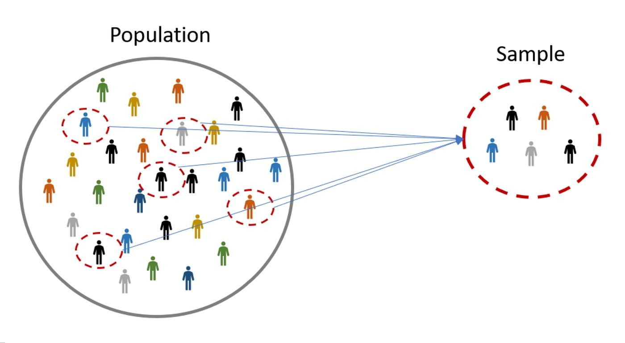
Population and Sample
A population is the entire group or set of individuals, items, or data points of interest that one aims to study or describe.
A sample is a subset of the population selected for investigation, used to infer or make generalizations about the entire population.

Slide 10
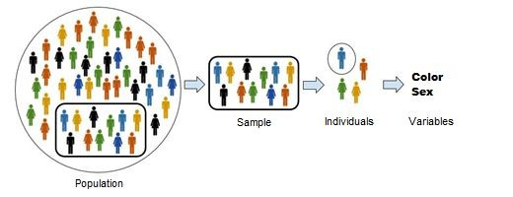
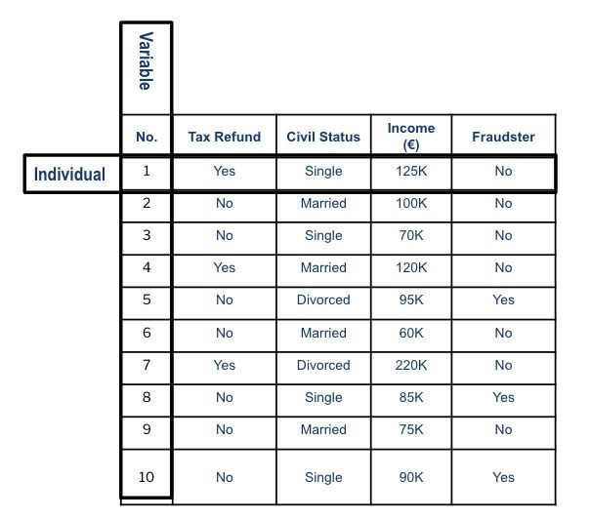
Variables and Individuals
An individual is a single entity or member of a population or sample for which data is observed or collected.
A variable is a characteristic or attribute that can assume different values or categories across observations.

Slide 11
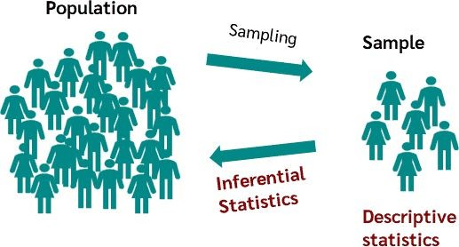
What is Statistics?
Statistics can be broken down into two areas:
Descriptive statistics:
Describes and summarizes data.
Example: the average SAT score for incoming freshmen; racial makeup of the student body
Inferential statistics:
Makes inferences about populations (e.g. all universities in the country) using data drawn from sample data (e.g. from one university) of that population.
Includes hypothesis testing, confidence intervals, and regression analysis.

Slide 12
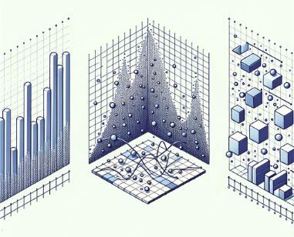
Descriptive Statistics
According to the number of variables being analyzed simultaneously:
Univariate Analysis:
Focuses on a single variable. The aim is to understand the
distribution, central tendency, and variability of the data.
Bivariate Analysis:
Examines the relationship or association between two variables.
Multivariate Analysis:
Involves analyzing three or more variables simultaneously. The aim is often to understand the relationships among multiple variables or to reduce the number of variables.

Slide 13
Data Types

Slide 14
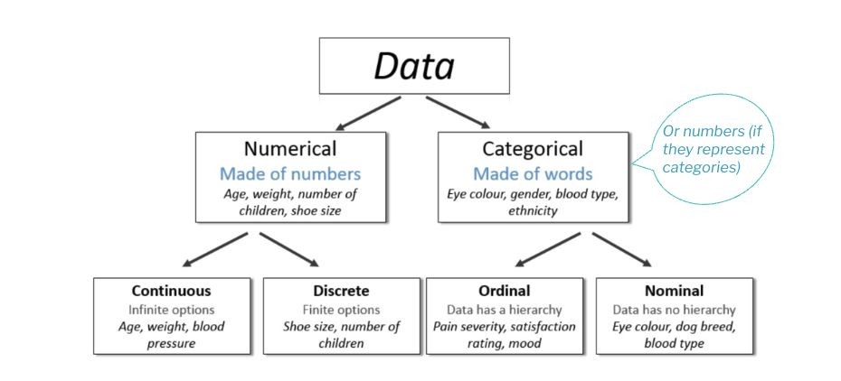
Data Types
Data can be broadly classified into different types, and the techniques we apply for analysis depend on the data type at hand.

Slide 15
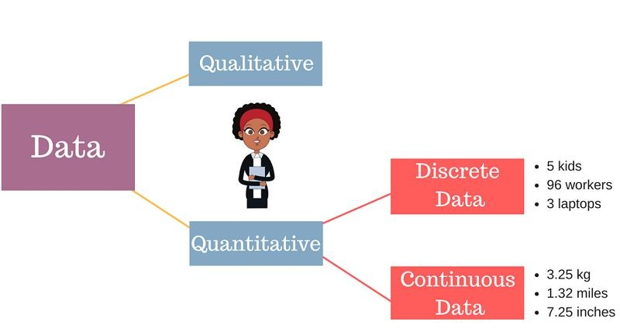
Numerical or Quantitative Data
Consists of values that can be measured or counted.
Discrete: can only take on specific values within a defined range or set. These values are often whole numbers and cannot be further subdivided.
Continuous: can take on any value within a specified range. It is not limited to whole numbers and can include decimal values.

Slide 16
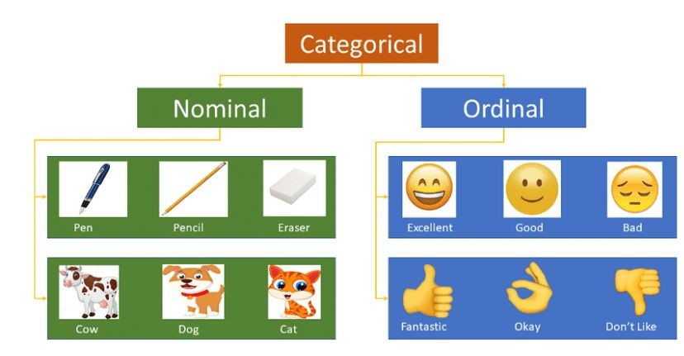
Categorical Data
Variables that are divided into distinct categories or groups.
Nominal: have no inherent order or ranking. Each category is distinct and independent, without any numerical or hierarchical relationship between them.
Ordinal: have a natural order or ranking. The categories possess a qualitative relationship of "more" or "less" compared to others but do not have a consistent or measurable difference between them.

Slide 17
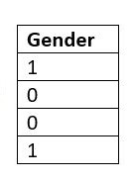
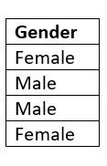
Important Note
In some cases, a numerical or quantitative variable may represent a categorical or qualitative variable.
For example: if a dataset includes a column with numerical values representing different categories or labels, such as "0" for "male" and "1" for "female," it should be treated as a categorical variable rather than a true numerical variable.
Always consider the context and meaning of the data when determining the appropriate data type.

Slide 18
Important Note: Tricks
Some tips and tricks to help you discern the nature of a numerical variable:
Unique Values: If it has a very small number of unique values, relative to the sample size, it might be categorical.
Operational Sense: If performing arithmetic operations (like addition or multiplication) on the variable doesn't make practical sense, it might be categorical. For instance, adding two ZIP codes doesn't have real-world meaning.
Context and Meaning: For example, the "number of doors in a car" is a discrete numerical variable that often gets treated as categorical because there are a limited number of common options (typically 2-door, 4-door, etc.), and these categories have specific implications in terms of car type (e.g., coupe vs. sedan). The choice of how to treat it depends on the analysis goals and the nature of the data at hand:
As a Numerical Variable: If you're studying the average number of doors in cars across different years or regions, then you might treat it as numerical.
As a Categorical Variable: If you're comparing preferences, sales, or other attributes between 2-door and 4-door cars, it might make more sense to treat it as a categorical variable, because you're essentially comparing two distinct groups.
Check For Understanding: is the course number in academic settings, numerical or categorical?

Slide 19
Transforming Variables
Categorical to Numerical and Vice Versa
In some cases, we need to convert between variable types. Here is why.
Categorical to Numerical:
Machine Learning Models: Many algorithms require numerical input.
Mathematical Operations: To perform calculations, aggregations, or statistical tests that require numerical values.
Feature Engineering: Creating new features or leveraging patterns that emerge only when categories are numerically encoded.
Numerical to Categorical:
Data Binning: Grouping a continuous variable into intervals can make analysis more intuitive and can highlight patterns better in some cases.
Handle Outliers: Transforming numerical data into categories can diminish the impact of outliers.

Slide 20
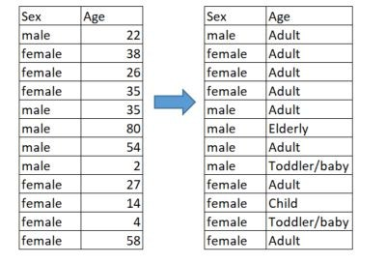
Transforming Variables
Numerical to Categorical
Fixed-Width Binning: Divide the range of the data into intervals of the same width. E.g., Age grouped into 0-18, 19-35, 36-60, and 60+.
Quantile Binning: Create bins such that each bin has (approximately) the same number of data points. E.g., quartiles.
Custom Binning: Define custom intervals based on domain knowledge or specific requirements. E.g., young, adult, elderly.
The resulting variable should strike a balance between detailed granularity and a concise overview, ensuring that the distribution's information isn't lost.

Slide 21
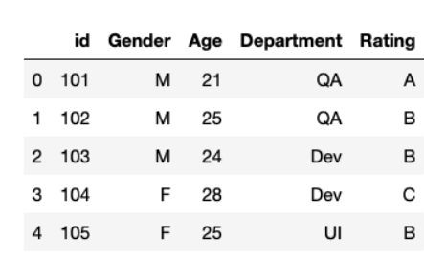
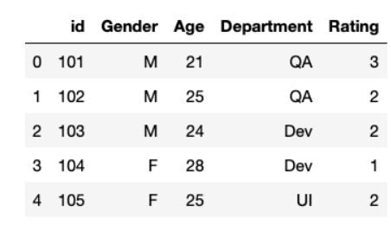

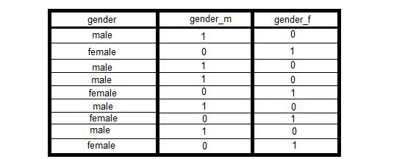
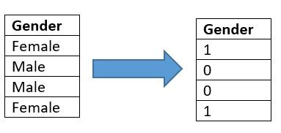
Transforming Variables
Categorical to Numerical
Label Encoding: Assign each category a unique number. This works well for ordinal data where there's a clear order.
One-Hot Encoding (Dummy Variables): For each category, create a new binary column (0 or 1). This avoids imposing an artificial order but increases data dimensionality.

Slide 22

Univariate Analysis
Exploring Single Variables in Depth

Slide 23

Univariate Analysis
When working with categorical data, we focus on understanding the frequency counts and proportions within each category.
When working with numerical data, we focus on understanding the central tendency (measures of centrality), the variability (measures of dispersion) within the dataset and the distributions of variables.

Slide 24
Univariate Analysis
Categorical & Discrete Variables

Slide 25
Categorical & Discrete Variables
Frequency Tables
Frequency Counts: Number of occurrences for each category.
Frequency types:
Absolute Frequency: The number of times a particular value appears in a dataset.
Relative Frequency: The proportion or fraction of times a value occurs.
Cumulative Frequency: The sum of the absolute frequencies of all values less than or equal to the current one.
Cumulative Relative Frequency: The sum of the relative frequencies of all values less than or equal to the current one.
OS | Absolute frequency | Relative frequency
Android | 230 | 0.46
iOS | 250 | 0.50
Windows | 15 | 0.03
Other | 5 | 0.01
Total | 500 | 1
Survey of 500 users about the operating system on their primary mobile device.

Slide 26
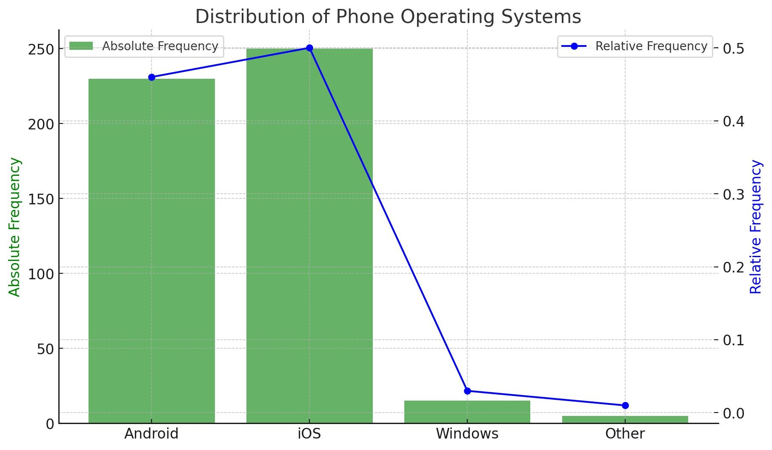
Categorical & Discrete Variables
Visualization -Bar Charts
Display frequency or proportion of each category.
The length of each bar corresponds to the quantity or magnitude of the category it represents.
The green bars represent the Absolute Frequency of each operating system.
The blue line with markers represents the Relative Frequency of each operating system.

Slide 27
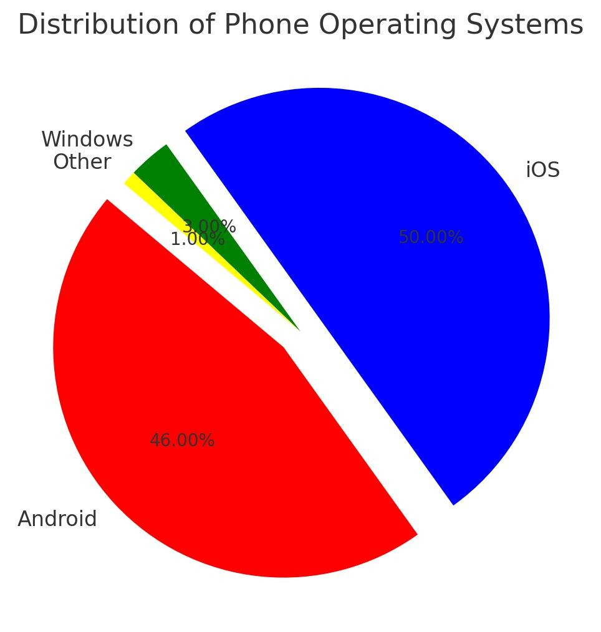
Categorical & Discrete Variables
Visualization -Pie Charts
Show proportion of each category relative to the whole. Use sparingly and only when categories are few.
The chart provides a visual representation of the proportion each operating system holds relative to the whole.
The percentages on each slice represent the relative frequencies (or proportions) of each operating system.

Slide 28
Univariate Analysis
Numerical Continuous Variables

Slide 29
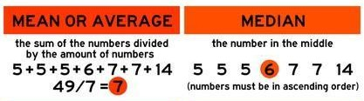
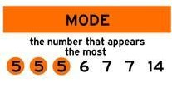
Continuous Variables
Central Tendency
Measures of centrality provide insights into the central or typical value of a dataset.
Mean: Average of all values. Sensitive to outliers, which can skew the mean.
Median: Middle value when data is sorted (for even number of values, it's the average of the two middle numbers). More resistant to outliers.
Mode: Most frequently occurring value. Applicable to both numerical and categorical data.
A dataset can be unimodal (one mode), bimodal (two modes), or multimodal (more than two modes).

Slide 30
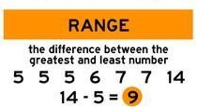
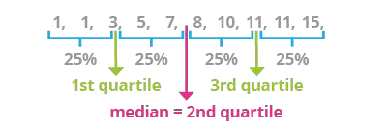
Continuous Variables
Measures of Spread
Measures of spread describe how spread out or dispersed a set of data is.
Minimum, Maximum and Range:
Range: Difference between maximum and minimum values.
Very sensitive to outliers.
Percentiles & Quartiles: Divide data into parts to understand distribution.
Quartiles: Quartiles split your data into four equal parts.
First Quartile (Q1): 25% of values are below this.
Second Quartile (Q2): This is the middle value, with half Below and half above (also known as the median).
Third Quartile (Q3): 75% of values are below this.
Percentiles: Same as quartiles but with any value between 1 and 99. Example: If your exam score is at the 80th percentile, it means you did better than 80% of people.

Slide 31
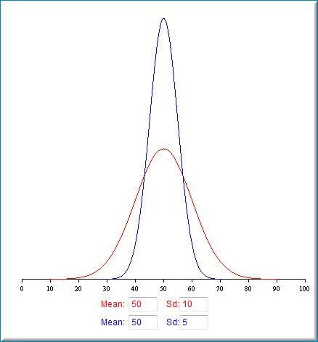
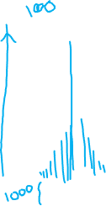

Continuous Variables
Measures of Spread
Variance:
Average of the squared differences from the mean.
Standard Deviation:
Square root of the variance. Indicates the spread of data around the mean.
Here we see two distributions. They both have the same mean.
The distribution that is more spread out and lower in the middle has the larger standard deviation.

Slide 32
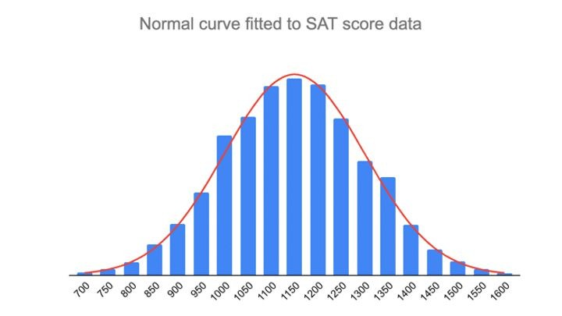


Continuous Variables
Note: example of a Distribution

Slide 33
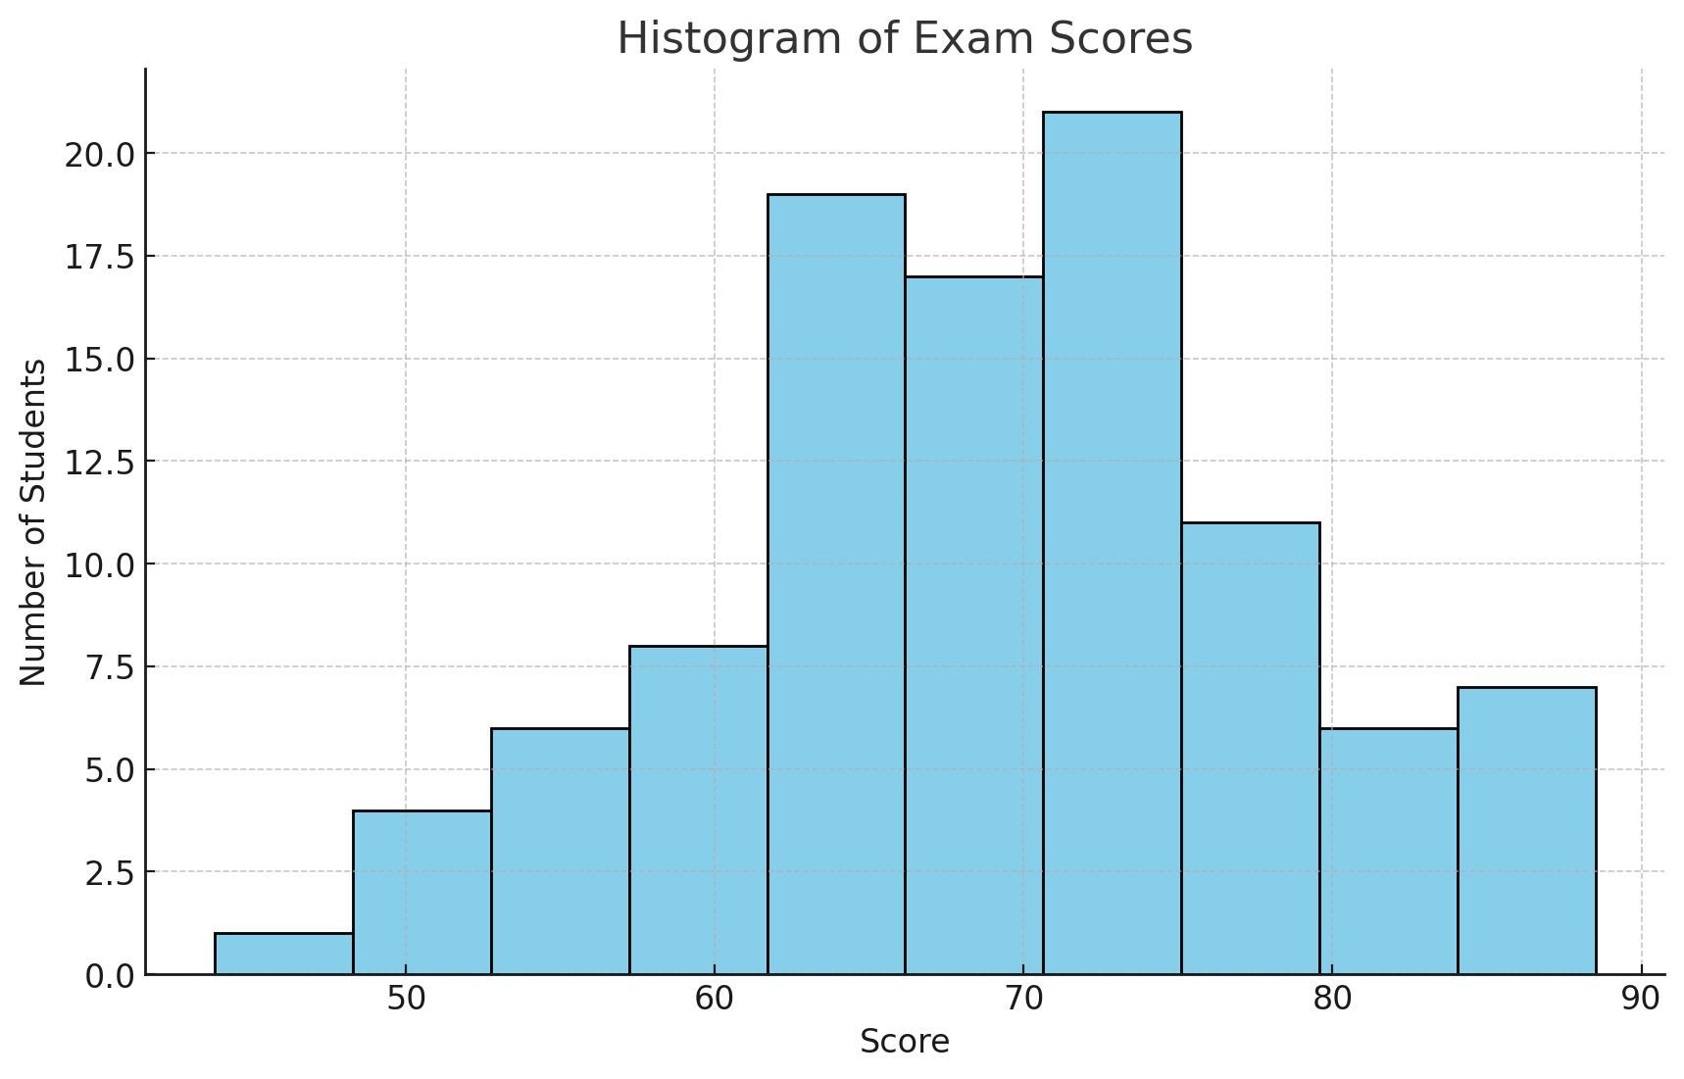

Continuous Variables
Visualization - Histograms
An histogram is a graphical representation of the distribution of a dataset.
The data range is divided into intervals (bins).
The width of the bin affects the histogram:
Narrow bins might show too much noise
Wide bins might hide important details.
Difference from Bar Chart: In histograms, bars are adjacent with no gap between them, while bar charts (for categorical and discrete) have distinct bars separated by spaces.
Histogram illustrating the distribution of exam scores for 100 students

Slide 34
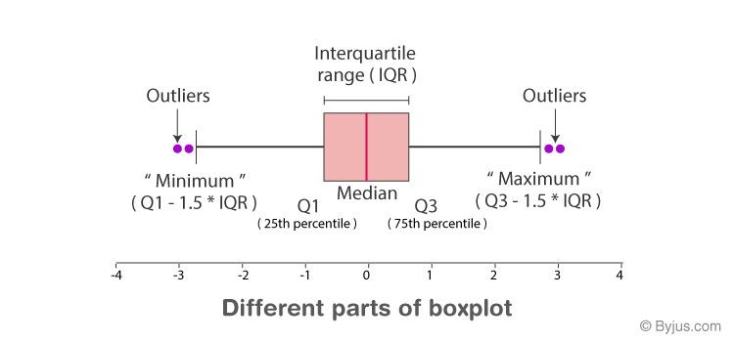


Continuous Variables
Visualization - Box Plots
Box plots provide a visual summary of the data's distribution, including its central value, variability, and any potential outliers.
They are especially useful for comparing distributions across different groups (displayed in parallel).
Box: spans from Q1 to Q3. This represents the Interquartile Range (IQR = Q3 - Q1), where the middle 50% of the data lies.
Whiskers: lines that extend from both
ends of the box (Q3 1.5 * IQR).
Outliers: Data points that fall outside the whiskers' range.
+

Slide 35
Summary

Slide 36
Summary
Univariate Analysis: Focuses on a single variable
Categorical variables:
Frequency tables. Counts and proportions.
Visualizations: Bar charts, pie charts
Numerical variables:
Measures of centrality:
Mean, median, mode
Measures of dispersion:
Variance, standard deviation, minimum, maximum, range, quantiles
Shape of the Distribution:
Symmetry and kurtosis
Visualizations: Histograms, box plots

Slide 37
APPENDIX

Slide 38
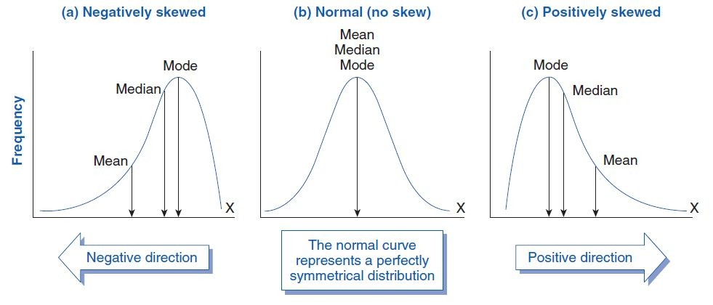
Continuous Variables
Shape of the Distribution
Measures that indicate the shape of the distribution without needing a visual display.
Skewness: Measure of the
asymmetry of the distribution.
Positive skew: Tail on the right.
Mean > Median > Mode
Negative skew: Tail on the left.
Mode > Median > Mean

Slide 39
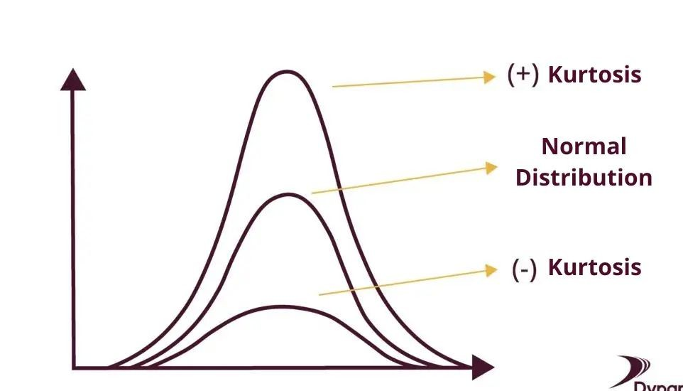
Continuous Variables
Shape of the Distribution
Measures that indicate the shape of the distribution without needing a visual display.
Kurtosis: Measure of the "tailedness" of the distribution.
High kurtosis: Heavy tails (more disperse), more outliers.
Low kurtosis: Light tails, fewer outliers.
Zero or Moderate Kurtosis: The distribution has a shape relatively equivalent to a normal distribution.

Slide 40
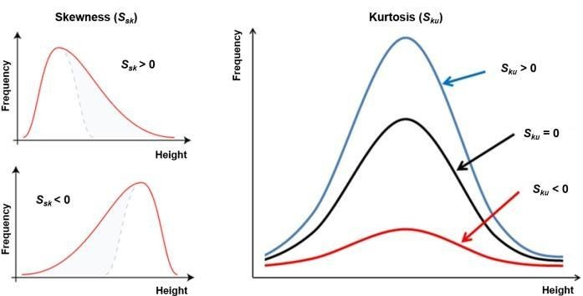
Continuous Variables
Shape of the Distribution - Comparison

